Slide 1


DATA MINING
Term Deposit Project
Hien Do & Khanh Dang
M.S.B.A
Prof. Myriam Quispe-Agnoli
Notes:
https://pixabay.com/en/achievement-agreement-business-3481967/

Slide 2


01
Business idea and its motivation
02
Exploring data
Agenda
03
Data Cleaning & Data Dimension
04
Logistic Regression
05
K-Nearest Neighbors (KNN)
06
Naïve Bayes Classifier
Notes:
https://pixabay.com/en/open-book-library-education-read-1428428/

Slide 3
Business idea and its motivation
Why Term Deposit?
Growing recent time due to the important role in raising fund and lending capacity of the bank
Safe investment
Our Goals?
Main goal: classification goal: Basing on customers’ demography such as job, education,…and marketing campaign: contact type, duration of contact, number of campaigns => build predictive model to predict whether potentials customers will accept term deposit or not
Ranking goal: finding a certain percentage of customers that are most likely to invest on term deposit
Profiling goal: finding out which factors are associated with customer’s decision on buying term deposit, and for those we would like to quantity these factors

Slide 4
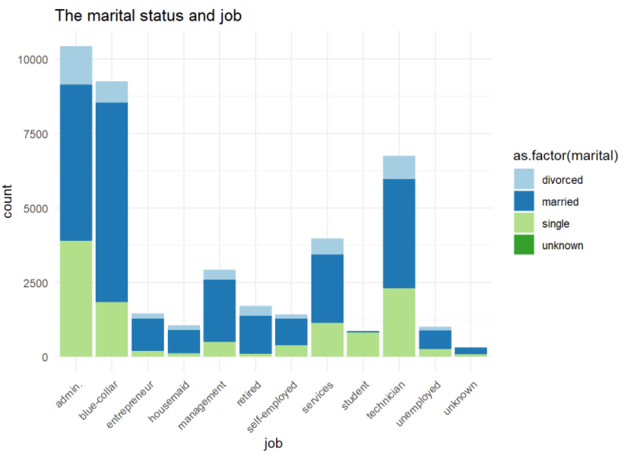
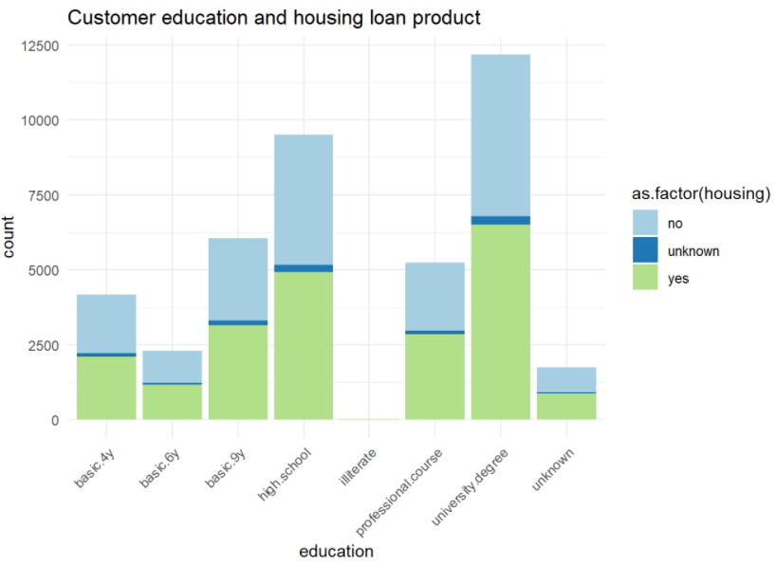
Exploring data
Higher proportion of married customer in the portfolio compare to the other groups as single and divorced and most of them work as admin, blue-collar and technician.
There is equalized in the number of customers who have the housing loan and those are not regardless the educational level.

Slide 5
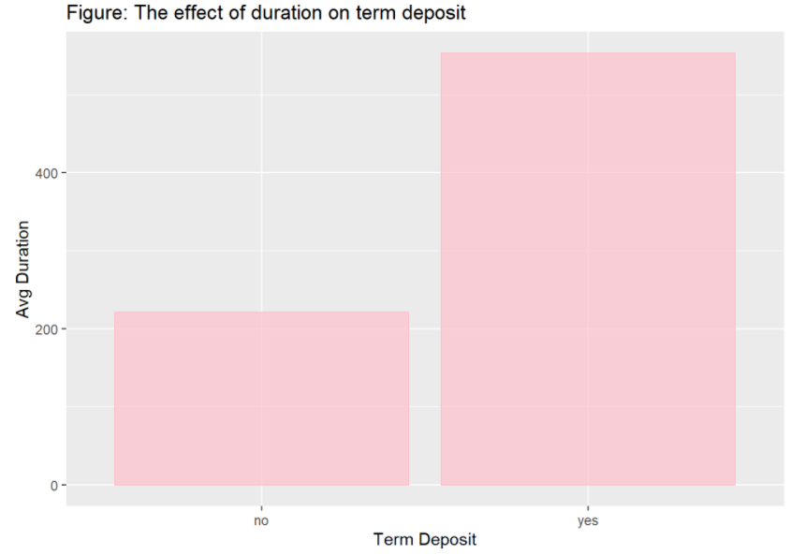
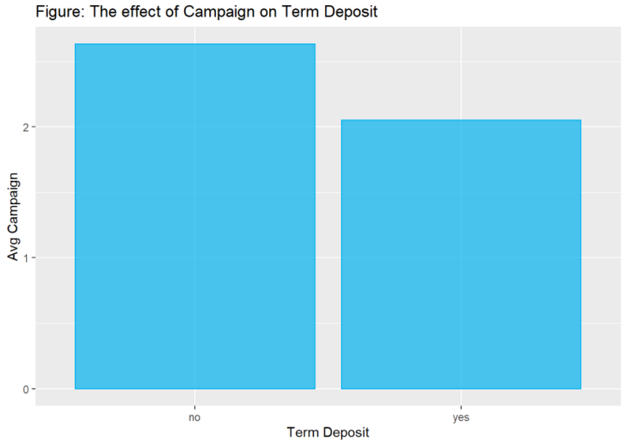
Exploring data
The average of duration is higher with term deposit yes than that of no. It means that higher duration, the more probability that customer will subscribe term deposit.
If customer subscribes the term deposit, the average of contacting for the bank is only 2.

Slide 6
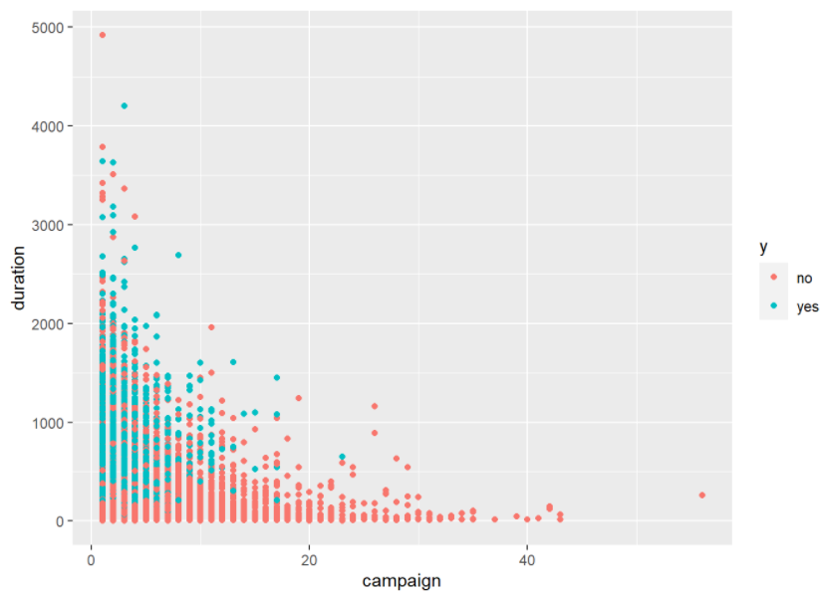
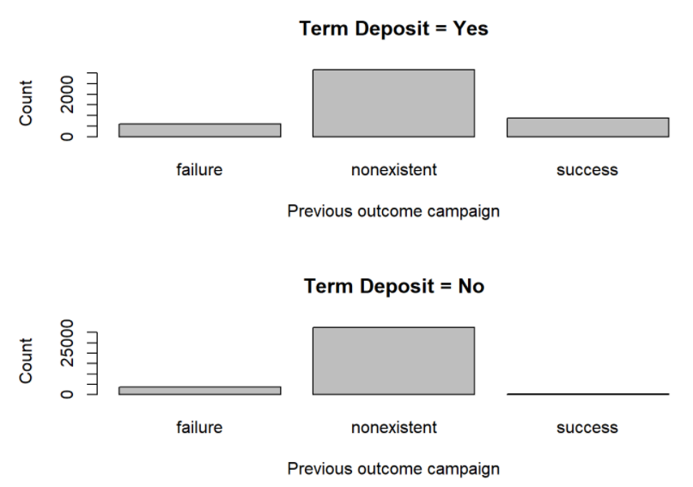
Exploring data
If the previous outcome was successful, there is more likely that customer will subscribe term deposit.
When the number of contact is high, the duration is low then there is more likely that customer will not purchase term deposit.

Slide 7
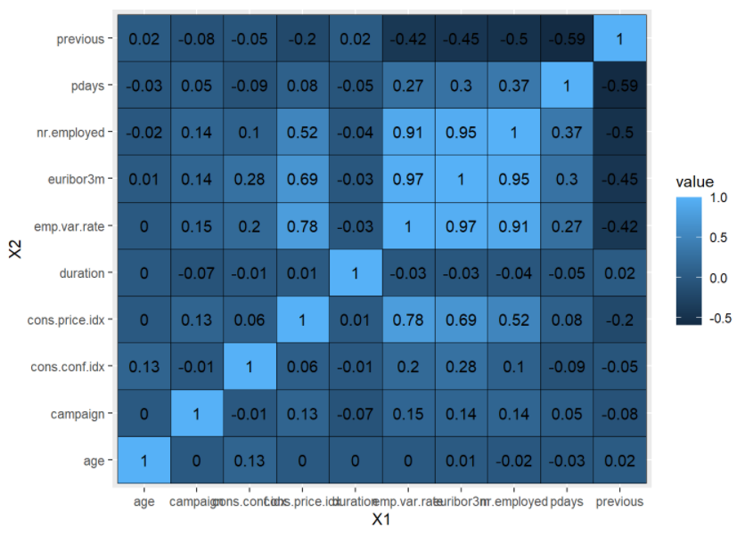
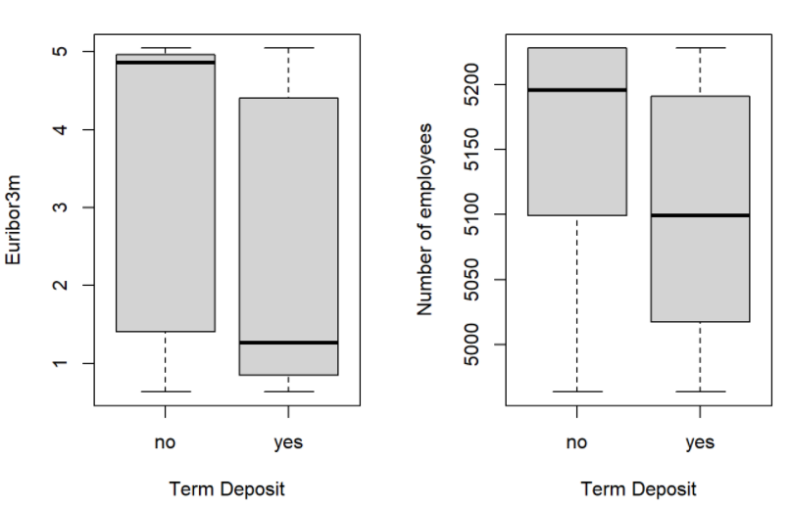
Exploring data
The customer who bought term deposit has median of Euribor 3-month rate and number of employees much less than its of customer who didn’t subscribe term deposit.
The heatmap shows that emp.var.rate vs euribor3m, emp.var.rate vs nr.employed are strongly correlated.

Slide 8
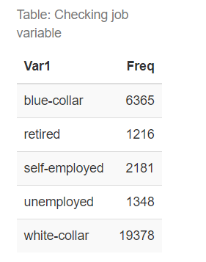
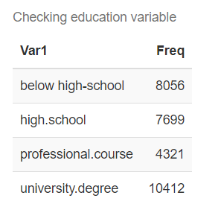
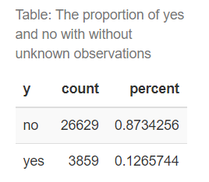
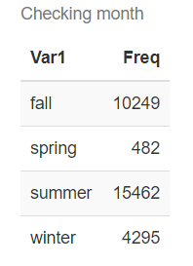
Data cleaning & dimension
Removing unknown values: after removing all unknown observations, the dimension of dataset is 30,488 records and the proportion of yes/no is still the same
11 dummy variables in job are grouped into 5 groups: self-employed, white-collar, blue-collar, retired, and unemployed.
7 dummy variables in education are grouped into 4 groups: below high school, high school, professional course and university degree
Months: group into 4 seasons: spring, summer, fall, winter
Pdays: change “999” values into “0”.

Slide 9
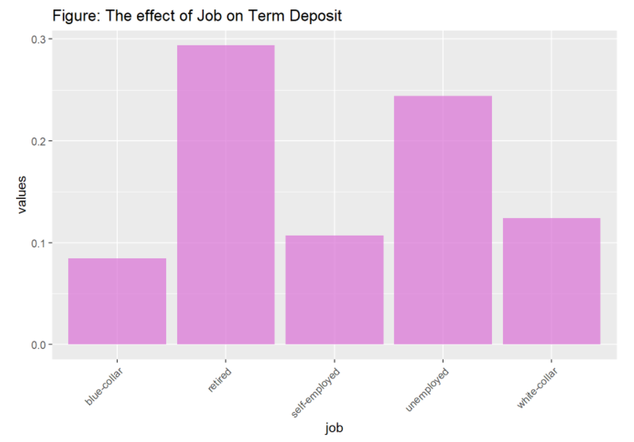
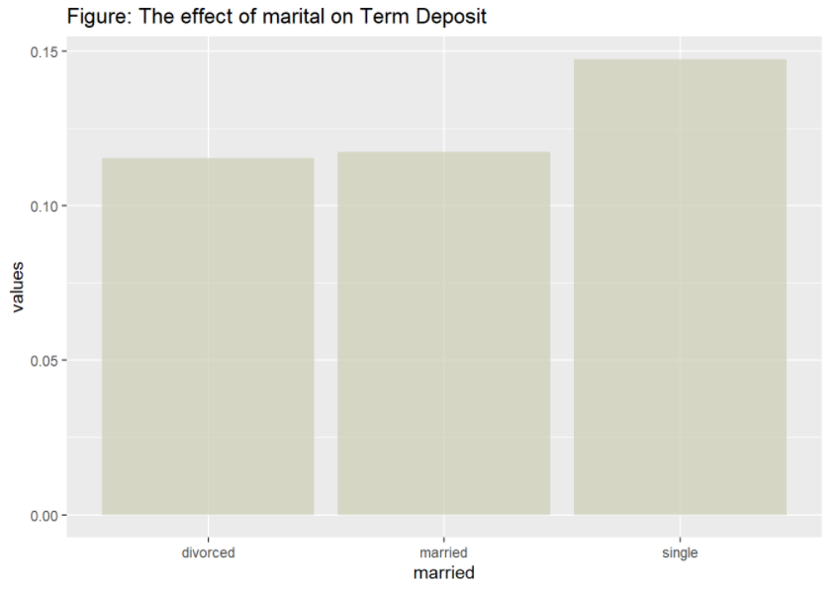
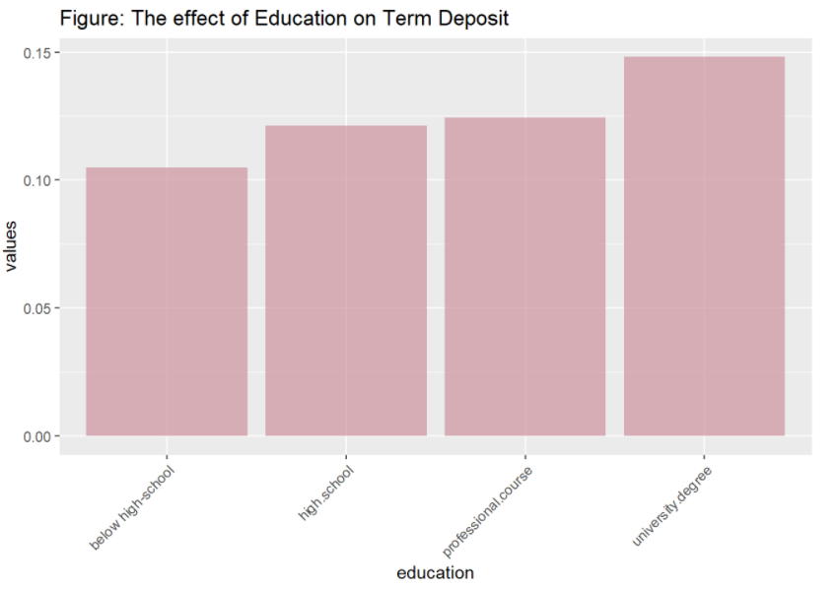
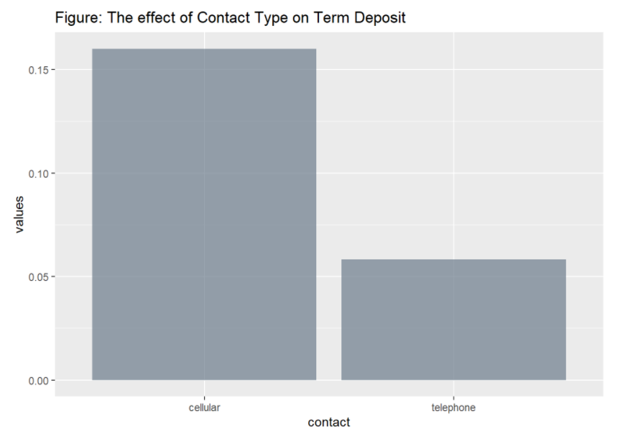
Data cleaning & dimension

Slide 10
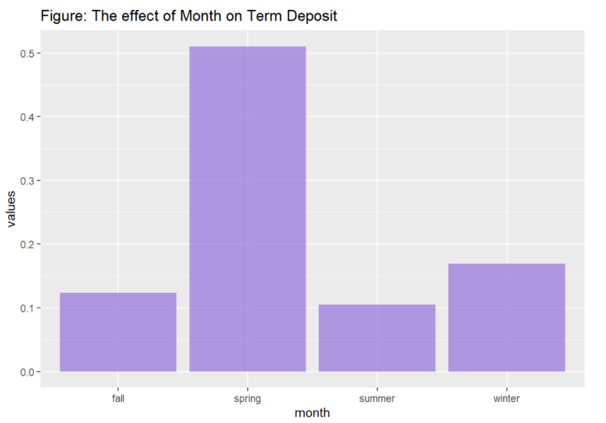
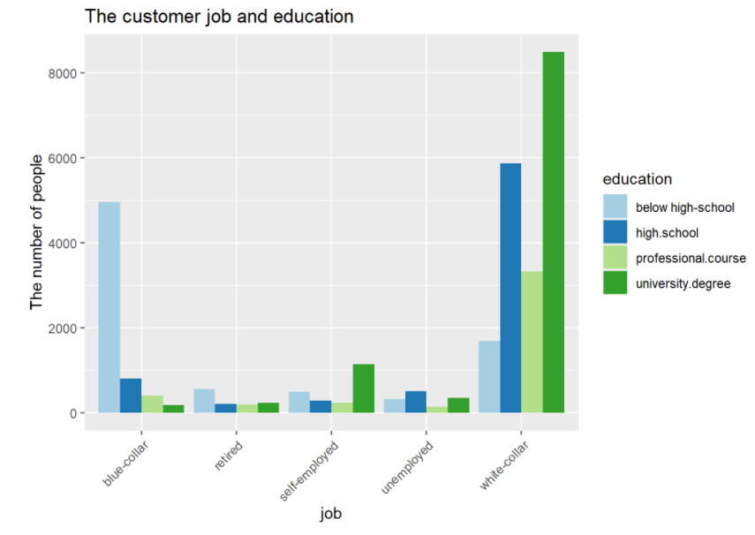
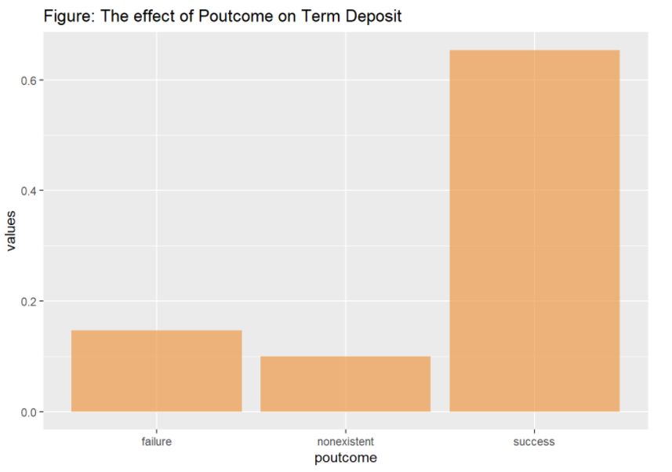
Data cleaning & dimension

Slide 11
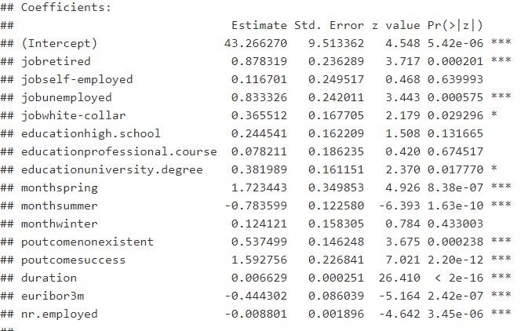

Logistic regression
After running two models of logistic regression and assessing the predictive performance, the backward elimination model with predictors: job, marital, education, contact type, month, poutcome, duration, campaign, euribor3m, nr.employed is the best model with accuracy rate at 89.8% and cutoff value 0.85

Slide 12
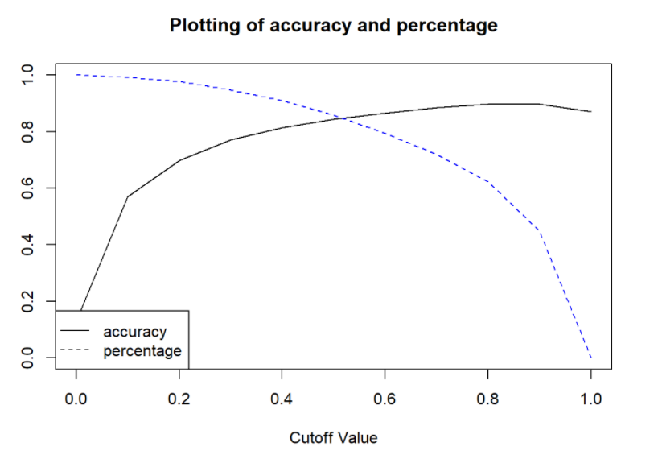
Logistic regression
Case: Predicting the number of customer who will purchase term deposit is more important.
Model with backward elimination and cutoff value at 0.5: The percentage of customers correctly identified to purchase term deposit is 85.75% and the accuracy rate is a little bit lower at 84%. However, it is still a good predictive model.

Slide 13
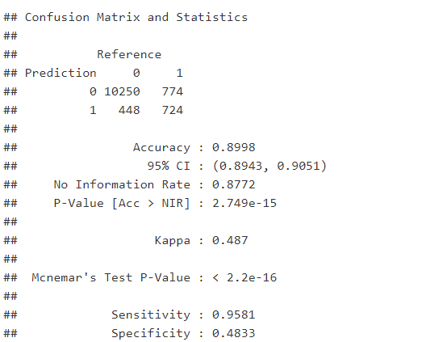
K-Nearest Neighbors
The value of K at 13 gives the best predictive model with accuracy rate of 90%
In case the defining the customers, who will purchase term deposit, the performance of KNN is not good, with the percentage of customer correctly classified as buying term deposit is 48.33%.

Slide 14
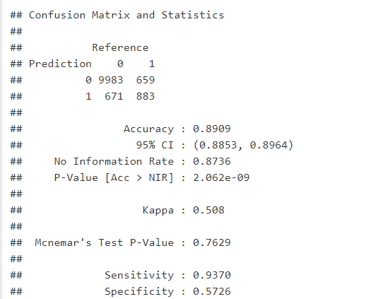
Naïve Bayes classifier
The accuracy rate of Naïve Bayes model is 89% which is good model. However, its accuracy rate is a little bit less than logistic regression model and KNN model.
The percentage of customer correctly classified as purchasing term deposit is just 57.26%.

Slide 15
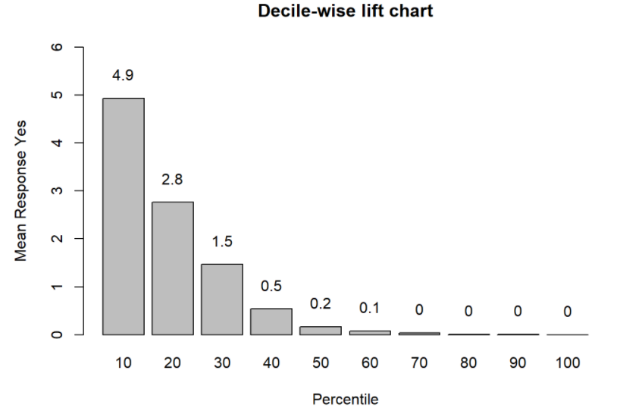
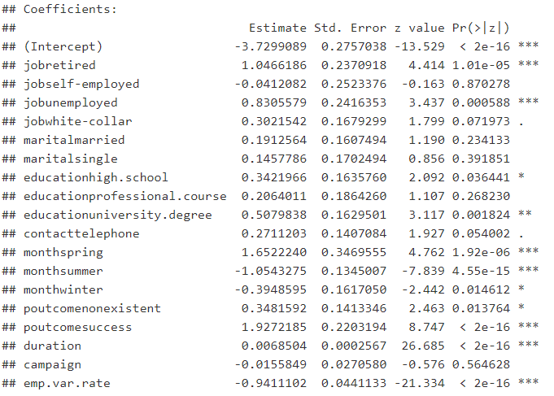
Ranking and Profiling
Ranking: The first bar chart shows that for the first 10% of observations, we are getting more than 5 times in terms of a response (customer will buy term deposit) as well as just random assignment
Profiling: factors that are associated with buying term deposit is the customers who are retired, have the university degree, have successful outcome in previous campaign and the bank should contact them in spring, they are the most likely to buy term deposit.

Slide 16

Thank you for your listening
Notes:
https://pixabay.com/en/question-mark-labyrinth-lost-maze-2648236/

